Slide 1
Concurrency control
6.2

Slide 2
Concurrency control
Executing a single transaction at a time will increase the waiting time of the other transactions which may result in delay in the overall execution.
Hence for increasing the overall throughput and efficiency of the system, several transactions are executed.
Concurrency control is a very important concept of DBMS which ensures the simultaneous execution or manipulation of data by several processes or user without resulting in data inconsistency.
Concurrency control provides a procedure that is able to control concurrent execution of the operations in the database.

Slide 3
Concurrency Control Problems
The database transaction consist of two major operations “Read” and “Write”.
It is very important to manage these operations in the concurrent execution of the transactions in order to maintain the consistency of the data.
Dirty Read Problem(Write-Read conflict)
Dirty read problem occurs when one transaction updates an item but due to some unconditional events that transaction fails but before the transaction performs rollback, some other transaction reads the updated value. Thus creates an inconsistency in the database.
Lost Update Problem
Lost update problem occurs when two or more transactions modify the same data, resulting in the update being overwritten or lost by another transaction.

Slide 4
Concurrency Control Protocols
Two-phase locking Protocol
Time stamp ordering Protocol
Multi version concurrency control
Validation concurrency control

Slide 5
Two-phase locking Protocol
It’s called “two-phase” because, during each transaction, there are two distinct phases: the Growing phase and the Shrinking phase.
Phases:
Growing Phase: During this phase, a transaction can obtain (acquire) any number of locks as required but cannot release any. This phase continues until the transaction acquires all the locks it needs and no longer requests.
In the growing phase, a new lock on the data item may be acquired by the transaction, but none can be released.
Shrinking Phase: Once the transaction releases its first lock, the Shrinking phase starts. During this phase, the transaction can release but not acquire any more locks.
In the shrinking phase, existing lock held by the transaction may be released, but no new locks can be acquired.
The primary purpose of the Two-Phase Locking protocol is to ensure conflict-serializability, as the protocol ensures a transaction does not interfere with others in ways that produce inconsistent results

Slide 6
2. Time stamp ordering Protocol
The Timestamp Ordering Protocol is a concurrency control method used in database management systems to maintain the serializability of transactions.
The Timestamp Ordering Protocol is used to order the transactions based on their Timestamps.
The order of transaction is nothing but the ascending order of the transaction creation.
The priority of the older transaction is higher that's why it executes first.
To determine the timestamp of the transaction, this protocol uses system time or logical counter.

Slide 7
Example:
Let’s assume there are two transactions T1 and T2.
Suppose the transaction T1 has entered the system at 007 times and transaction T2 has entered the system at 009 times.
T1 has the higher priority, so it executes first as it is entered the system first.
The timestamp ordering protocol also maintains the timestamp of last 'read' and 'write' operation on a data

Slide 8
Basic Timestamp ordering protocol works as follows:
1. Check the following condition whenever a transaction Ti issues a Read (X) operation:
If W_TS(X) >TS(Ti) then the operation is rejected.
If W_TS(X) <= TS(Ti) then the operation is executed.
Timestamps of all the data items are updated.
2. Check the following condition whenever a transaction Ti issues a Write(X) operation:
If TS(Ti) < R_TS(X) then the operation is rejected.
If TS(Ti) < W_TS(X) then the operation is rejected and Ti is rolled back otherwise the operation is executed.

Slide 9
Where,
TS(TI) denotes the timestamp of the transaction Ti.
R_TS(X) denotes the Read time-stamp of data-item X.
W_TS(X) denotes the Write time-stamp of data-item X.

Slide 10
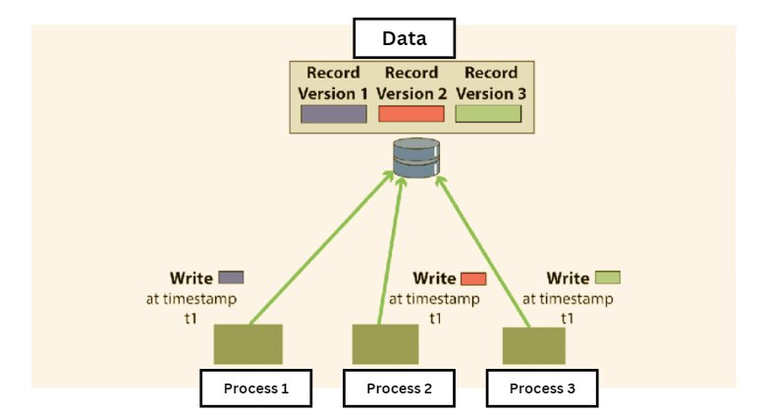
Multi version concurrency control
It is a technique used in database management systems to handle concurrent operations without conflicts, using multiple versions of a data item. Instead of locking the items for write operations (which can reduce concurrency and lead to bottlenecks or deadlocks), MVCC will create a separate version of the data item being modified.

Slide 11
Breakdown of the Multi version concurrency control (MVCC)
Multiple Versions: When a transaction modifies a data item, instead of changing the item in place, it creates a new version of that item. This means that multiple versions of a database object can exist simultaneously.
Reads aren’t Blocked: One of the significant advantages of MVCC is that read operations don’t get blocked by write operations. When a transaction reads a data item, it sees a version of that item consistent with the last time it began a transaction or issued a read, even if other transactions are currently modifying that item.
Timestamps or Transaction IDs: Each version of a data item is tagged with a unique identifier, typically a timestamp or a transaction ID. This identifier determines which version of the data item a transaction sees when it accesses that item. A transaction will always see its own writes, even if they are uncommitted.
Garbage Collection: As transactions create newer versions of data items, older versions can become obsolete. There’s typically a background process that cleans up these old versions, a procedure often referred to as “garbage collection.”
Conflict Resolution: If two transactions try to modify the same data item concurrently, the system will need a way to resolve this. Different systems have different methods for conflict resolution. A common one is that the first transaction to commit will succeed, and the other transaction will be rolled back or will need to resolve the conflict before proceeding

Slide 12
Validation Based Protocol
Validation phase is also known as optimistic concurrency control technique.
In the validation based protocol, the transaction is executed in the following three phases:
Read phase:
In this phase, the transaction T is read and executed. It is used to read the value of various data items and stores them in temporary local variables. It can perform all the write operations on temporary variables without an update to the actual database.
Validation phase:
In this phase, the temporary variable value will be validated against the actual data to see if it violates the serializability.
Write phase:
If the validation of the transaction is validated, then the temporary results are written to the database or system otherwise the transaction is rolled back.

Slide 13
Here each phase has the following different timestamps:
Start(Ti): It contains the time when Ti started its execution.
Validation (T_{i}): It contains the time when Ti finishes its read phase and starts its validation phase.
Finish(Ti): It contains the time when Ti finishes its write phase
This protocol is used to determine the time stamp for the transaction for serialization using the time stamp of the validation phase, as it is the actual phase which determines if the transaction will commit or rollback.
Hence TS(T) = validation(T).
The serializability is determined during the validation process. It can't be decided in advance.
While executing the transaction, it ensures a greater degree of concurrency and also less number of conflicts.
Thus it contains transactions which have less number of rollbacks.

Slide 14
Types of Locks
Binary Lock: A data item is either locked (1) or unlocked (0).
Shared Lock (S-Lock):Allows multiple transactions to read the data. Used for read-only operations.
Exclusive Lock (X-Lock):Allows only one transaction to write/update. No other transaction can read/write until the lock is released.

Slide 15
Binary lock
Use binary locking in scenarios where:
You want a simple lock mechanism (either locked or unlocked).
Only one transaction should access a data item at a time (no shared reading).
You are dealing with basic concurrency control in small or educational systems.
You don’t need granular control like allowing multiple readers (as in shared/exclusive locks).

Slide 16
Example
Assume two transactions T1 and T2 are trying to access the same account balance record.
Initial state:
Account balance: ₹1000
Transaction T1:
BEGIN;
SELECT balance FROM account WHERE acc_id = 1;
-- wants to read balance
-- acquires Shared Lock (S-Lock)

Slide 17
Transaction T2:
BEGIN;
UPDATE account SET balance = balance - 500 WHERE acc_id = 1;
-- wants to write/update balance
--needs Exclusive Lock (X-Lock)
Since T1 holds a shared lock, T2 must wait until T1 releases the lock. This ensures:
T2 does not update while T1 is reading.
T1 does not read dirty data while T2 is updating.

Slide 18
Lock Release
Locks are released when a transaction commits or rolls back.
Two-Phase Locking (2PL) ensures serializability:
Growing phase: Locks acquired, no release.
Shrinking phase: Locks released, no acquisition.

Slide 19
Deadlock
A deadlock is a condition where two or more transactions are waiting indefinitely for one another to give up locks.
Deadlock is said to be one of the most feared complications in DBMS as no task ever gets finished and is in waiting state forever.

Slide 20
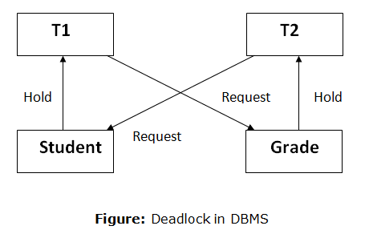
Example
In the student table, transaction T1 holds a lock on some rows and needs to update some rows in the grade table.
Simultaneously, transaction T2 holds locks on some rows in the grade table and needs to update the rows in the Student table held by Transaction T1.

Slide 21
Deadlock Avoidance
When a database is stuck in a deadlock state, then it is better to avoid the database rather than aborting or restating the database.
This is a waste of time and resource.
Deadlock Avoidance is a strategy used in database management systems and operating systems to ensure that deadlock situations are prevented before they occur.
Unlike deadlock detection, which deals with resolving deadlocks after they happen, deadlock avoidance proactively manages resource allocation to avoid the circular wait condition that leads to deadlock.

Slide 22
Key principles of deadlock avoidance include:
Safe State: The system always checks for a "safe state," meaning a sequence of process executions where each process can eventually complete without causing deadlock.
Resource Allocation Decisions: Resources are allocated in such a way that the system avoids creating conditions that could lead to a deadlock.

Slide 23
Deadlock Detection
In a database, when a transaction waits indefinitely to obtain a lock, then the DBMS should detect whether the transaction is involved in a deadlock or not.
Unlike deadlock avoidance, which tries to prevent deadlocks from happening in the first place, deadlock detection focuses on recognizing deadlock situations once they occur so they can be resolved.
The lock manager maintains a Wait for the graph to detect the deadlock cycle in the database.

Slide 24
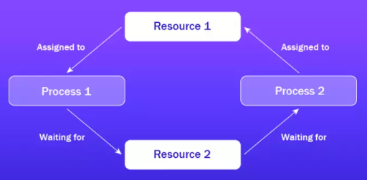
Resource Allocation Graph (RAG)
A common approach to detect deadlocks is to maintain a Resource Allocation Graph.
This graph represents processes and resources as nodes, and the edges indicate the relationships (e.g., a process holding a resource or requesting a resource).

Slide 25
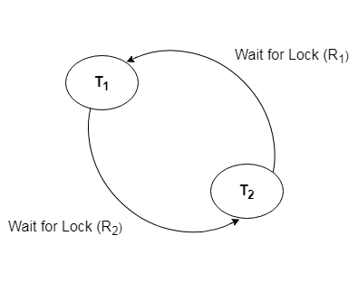
Wait-for-Graph
This is the suitable method for deadlock detection. In this method, a graph is created based on the transaction and their lock. If the created graph has a cycle or closed loop, then there is a deadlock.
The wait for the graph is maintained by the system for every transaction which is waiting for some data held by the others. The system keeps checking the graph if there is any cycle in the graph.
It is a variant of the Resource Allocation graph. In this algorithm, we only have processes as vertices in the graph. If the Wait-for-Graph contains a cycle then we can say the system is in a Deadlock state.
The Resource Allocation graph will be converted into Wait-for-Graph in an Algorithmic Approach.
We need to remove resources while converting
from Resource Allocation Graph to Wait-for-Graph.

Slide 26
Wait for graph algorithm
Step 1: Take the first process (Pi) from the resource allocation graph and check the path in which it is acquiring resource (R_{i}), and start a wait-for-graph with that particular process.
Step 2: Make a path for the Wait-for-Graph in which there will be no Resource included from the current process (P_{i}) to next process (P_{j}), from that next process (P_{j}) find a resource (R_{j}) that will be acquired by next Process (P_{k}) which is released from Process (P_{j}).
Step 3: Repeat Step 2 for all the processes.
Step 4: After completion of all processes, if we find a closed-loop cycle then the system is in a deadlock state, and deadlock is detected.

Slide 27
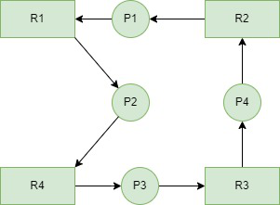
Example
Consider a Resource Allocation Graph with 4 Processes P1, P2, P3, P4, and 4 Resources R1, R2, R3, R4. Find if there is a deadlock in the Graph using the Wait for Graph-based deadlock detection algorithm.

Slide 28
Step1:
Process P1 which is waiting for Resource R1, resource R1 is acquired by Process P2, Start a Wait-for-Graph for the above Resource Allocation Graph.
Step 2: Now we can observe that there is a path from P1 to P2 as P1 is waiting for R1 which is been acquired by P2. Now the Graph would be after removing resource R1 looks like.

Slide 29
Step 3: From P2 we can observe a path from P2 to P3 as P2 is waiting for R4 which is acquired by P3. So make a path from P2 to P3 after removing resource R4 looks like.
Step 4: From P3 we find a path to P4 as it is waiting for P3 which is acquired by P4. After removing R3 the graph looks like this.
Step 5: Here we can find Process P4 is waiting for R2 which is acquired by P1. So finally the Wait-for-Graph is as follows:

Slide 30
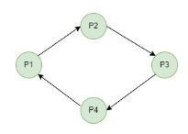
Step 6: Finally In this Graph, we found a cycle as the Process P4 again came back to the Process P1 which is the starting point (i.e., it’s a closed-loop).
So, According to the Algorithm if we found a closed loop, then the system is in a deadlock state. So here we can say the system is in a deadlock state.

Slide 31
Deadlock Prevention
Deadlock Prevention is a proactive strategy used to ensure that deadlock situations do not occur in a system.
The primary goal of deadlock prevention is to structure resource allocation in such a way that at least one of the four necessary conditions for deadlock is always violated, thereby preventing deadlocks from forming.
In deadlock prevention, the system enforces specific rules to avoid the conditions that lead to deadlock.

Slide 32
The Four Conditions for Deadlock:
Mutual Exclusion: A resource can only be held by one process at a time.
Hold and Wait: A process holding one resource is waiting for additional resources held by other processes.
No Preemption: Resources cannot be forcibly taken from a process; they must be released voluntarily.
Circular Wait: A circular chain of processes exists, where each process is waiting for the next process to release a resource.

Slide 33
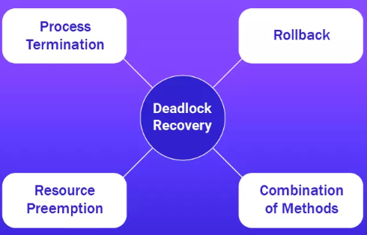
Deadlock Recovery

Slide 34
Recovery system
There are two different approaches:
– log-based recovery, and
– shadow-paging
log-based recovery
A log is kept on stable storage.
The log is a sequence of log records, and maintains a record of update activities on the database.
When transaction Ti starts, it registers itself by writing a < Ti start > log record
Before Ti executes write(X), a log record < Ti, X, V1, V2 > is written, where V1 is the value of X before the write, and V2 is the value to be written to X.
When Ti finishes it last statement, the log record < Ti commit > is written.
We assume for now that log records are written directly to stable storage (that is, they are not buffered)

Slide 35
Shadow paging
Shadow Paging is recovery technique that is used to recover database.
In this recovery technique, database is considered as made up of fixed size of logical units of storage which are referred as pages.
pages are mapped into physical blocks of storage, with help of the page table which allow one entry for each logical page of database.
This method uses two page tables named current page table and shadow page table.
The entries which are present in current page table are used to point to most recent database pages on disk.
Another table i.e., Shadow page table is used when the transaction starts which is copying current page table.
After this, shadow page table gets saved on disk and current page table is going to be used for transaction.
Entries present in current page table may be changed during execution but in shadow page table it never get changed.
After transaction, both tables become identical. This technique is also known as Cut-of-Place updating.

Slide 36
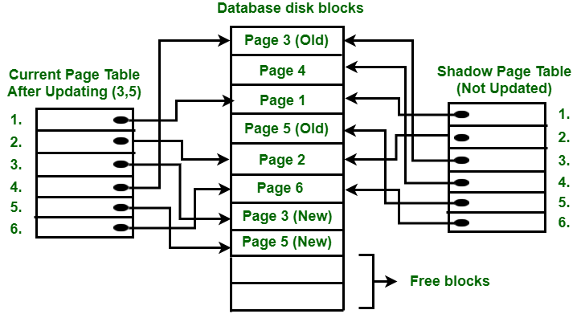

Slide 37
To understand concept, consider above figure. In this 2 write operations are performed on page 3 and 5. Before start of write operation on page 3, current page table points to old page 3. When write operation starts following steps are performed :
Firstly, search start for available free block in disk blocks.
After finding free block, it copies page 3 to free block which is represented by Page 3 (New).
Now current page table points to Page 3 (New) on disk but shadow page table points to old page 3 because it is not modified.
The changes are now propagated to Page 3 (New) which is pointed by current page table.

Slide 38
Each transaction holds a resource and waits for another in a circular chain
A transaction holds a lock and waits for another lock without releasing the first.
A technique used to identify deadlock by analyzing a transaction dependency graph

Slide 39
COMMIT Operation :
To commit transaction following steps should be done :
All the modifications which are done by transaction which are present in buffers are transferred to physical database.
Output current page table to disk.
Disk address of current page table output to fixed location which is in stable storage containing address of shadow page table.
This operation overwrites address of old shadow page table. With this current page table becomes same as shadow page table and transaction is committed.
Failure : If system crashes during execution of transaction but before commit operation, With this, it is sufficient only to free modified database pages and discard current page table.
Before execution of transaction, state of database get recovered by reinstalling shadow page table.
If the crash of system occur after last write operation then it does not affect propagation of changes that are made by transaction.
These changes are preserved and there is no need to perform redo operation.

Slide 40
A cycle in the Wait-For Graph indicates this condition
This type of lock allows multiple transactions to read data simultaneously
Resources cannot be taken away from a transaction holding them

Slide 41
This property of a transaction ensures it either completes fully or not at all
This method checks for the possibility of deadlock before allocating resources."

